Slide 1
DATA ANALYSIS
FOR
THE URBAN AND CO.
BY
Abubakr Salahudeen

Slide 2

introduction
Urban & Co. is a retail business specializing in premium clothing, electronics, and beauty accessories, operating across multiple online and physical locations. It has a diverse customer base to boost across all categories.
Their operational efficiency and ability to adapt to changing customers’ preferences are key to long-term success.

Slide 3

overview
This analysis examines the evolving relationship between urban environments and retail impact on businesses and consumers.
This project is a deep dive into the business operations of Urban & Co., with a dataset of 2000 records spanning from 2022-2023, with 11 columns containing sales transactions, customer data, product categories, and total sales.
The goal is to give our team the tools to make better, faster decisions! Whether that's optimizing inventory for future growth.

Slide 4
objectives
Primary Objective : Discover insights on sales trends, customer distribution, and category performance.
Category Growth : Promote balanced sales across all product categories.
Customer Engagement : Increase customer loyalty and drive repeat business.
Sales Analysis : Analyze the relationship between quantity sold and revenue across categories.
Maximize Profit Margins : Increasing the difference between sales revenue and costs so that the business keeps more profit.

Slide 5



Data cleaning and preparation
1
2
3
POWER BI VISUALIZATION
SQL
CHARTS & DASHBOARD
Power BI was used to clean, shape, and organize the data, making it easier to analyze and draw insights. It helped convert raw information into a structured format, allowing for clearer reporting.
SQL is a reliable tool for working with large datasets. It helps turn raw data into a clear, usable format, making it easier to find patterns and trends without needing complicated formulas.
Doughnut Chart: Shows the distribution of overall sales by category.
Clustered Bar Chart: Shows how often transactions occur in each category.
Pie Chart: Shows the proportion of sales or items across different categories.
Line Chart: Summarizes trends over a continuous period.

Slide 6
Kpis Tracked
TOTAL RECORDS
UNIQUE RECORDS
PRODUCT CATEGORY
2000
155
3

Slide 7


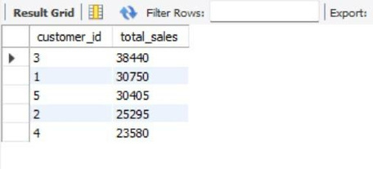
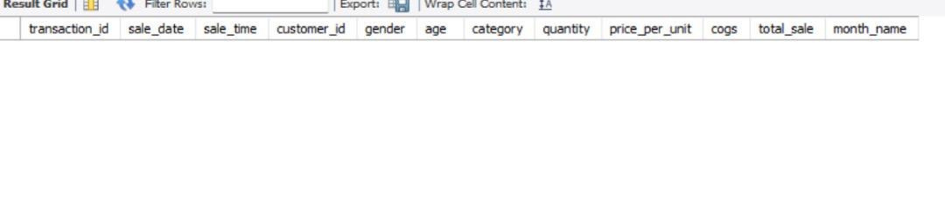
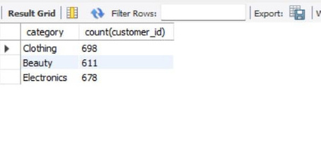
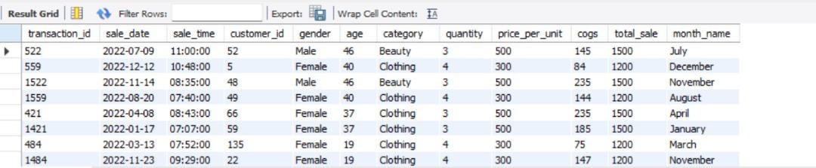
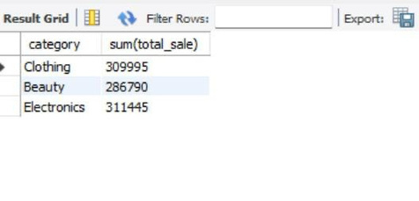
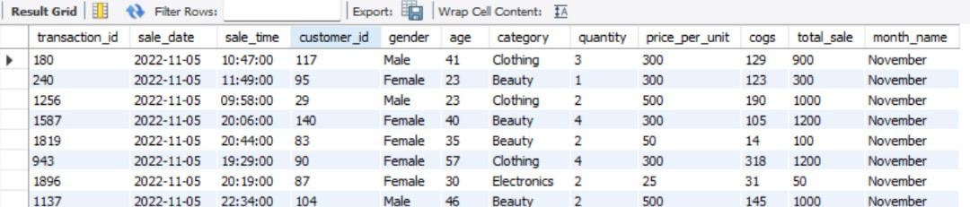
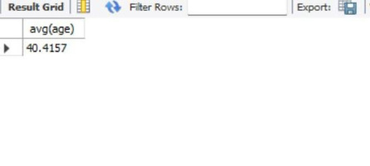
SQl result table

Slide 8
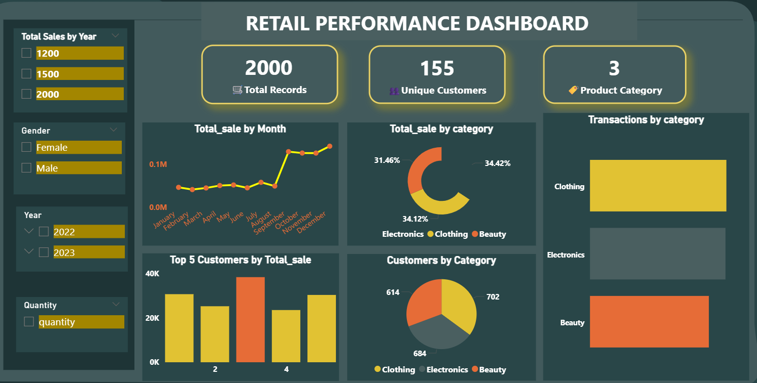
Dashboard design view

Slide 9
INSIGHTS DISCOVERED
From the dashboard analysis, we were able to discover the key performance indicators showing 2,000 total records, 155 unique customers, and 3 unique categories.
There’s been a decline in total sales from female customers, specifically from the beauty category, across the year 2022-2023.
A 3% growth in total sales across the year in all categories. Electronics contributing 34.42%, clothing giving about 34.12%
and beauty 31.46%.
The clothing category has more customers and transaction count, followed by the electronics and beauty respectively.
An upward trend in sales from Aug - Dec.
Most customers purchase only a small number of items, typically four or fewer.
With a total of 38,440 in sales, customer ID 3 was the top buyer.

Slide 10
Recommendation
There is a need to identify the cause of the decline in the beauty category. Tracking metrics to find root causes, such as product quality, shifts in trends, or negative brand events.
With the clothing and electronics categories being the top categories, they can be leveraged to boost sales in low-performing categories through cross-selling strategies.
Introduction of holiday season sales through marketing campaigns, promotional offers, and holiday bundles to encourage larger purchases and maximize sales during the peak period.
Assessment of products in the beauty category, such as introducing trending brands and new products to re-engage the female demographic.

Slide 11
Conclusion
The company ‘s sales show vulnerable growth due to uneven distribution across product categories. A clear seasonal pattern, likely influenced by holidays, suggests an opportunity to leverage these periods for increased sales.
Key findings indicate a widespread issue with small purchases, as the quantity ordered is consistently below four units per transaction. Additionally, the company is falling to retain its customer base, with a notable decline in sales within the beauty category. This suggests a loss of customer engagement and satisfaction in a critical market segment

Slide 12

THANK YOU!

